Slide 1
British Airways Passengers Reviews
Task 1: Web scraping and text analysis

Slide 2
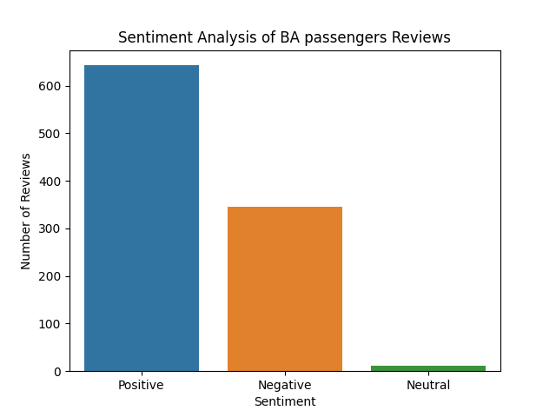
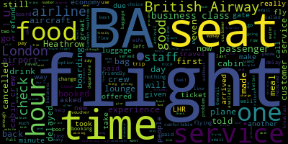
Wordcloud and Sentiment Analysis of Reviews
1. Wordcloud showed us the most frequent words in passenger reviews.
2. I also did sentiment analysis of reviews and plotted the results on a bar chart. There are more positive reviews than negative.
3. We can conclude that passengers are relatively happy with BA’s services

